Slide 1
The British Library’s METS Experience
The Cost of METS
Carl Wilson
carl.wilson@bl.uk
Notes:
Say a little about the BL, highlight the size of the collection and the amount of digital material.
Introduce myself, highlight the fact that I’m primarily an IT person rather than a librarian, just to emphasise my own perspective.

Slide 2
Introduction
A relatively young organisation, formed in 1971
A large collection of items, approximately 20 million
A rapidly growing collection of digital items, between 30 and 50 Terabytes
A large budget BUT
  The British Library is a large organisation with many responsibilities
  Large collections mean that efficiency is essential
    There seems to be a misconception in some quarters that METS is expensive
    Our experience suggests that METS saves costs but creating and collecting metadata to archive and preserve digital objects can be expensive regardless of methods used

Slide 3
The OAIS Reference Model
OAIS is the reference model for an Open Archival Information System
Provides a framework and a common vocabulary for archival concepts
Focused on long term digital information preservation and access
Key Terms:
  Submission Information Package (SIP)
  Archival Information Package (AIP)
  Dissemination Information Package (DIP)

Slide 4
SIPs, AIPs, and DIPs are all Information Packages
An Information Package contains Content Information and Preservation Description Information
Content
Information
Preservation
Description
Information
Packaging Information
Descriptive
Information
About Package

Slide 5
OAIS Archive External Data
High level view of OAIS data flow
Producer
OAIS Archive
Submission
Information
Package
Archival
Information
Package
Dissemination
Information
Package
Consumer

Slide 6
The British Library’s Digital Object Management System
Developed in response to Legal Deposit Legislation
  In principal a copy of all digital material published in the United Kingdom must be deposited at the British Library
  The British Library can claim material from the producer
  In practise the legislation is not yet in place, a Parliamentary Committee is still working on practical legislation

Slide 7
The British Library’s Digital Object Management System
Developed in house
Intended to provide a single preservation level store for the British Library’s digital content
Standards based
  Design modeled to fit the OAIS Reference Model
  We decided to use METS as:
    Submission Information Package
    Archival Information Package
    Dissemination Information Package

Slide 8
Why Use Standards?
Why should an organisation use standards?
  Avoid duplication of effort
  Build upon the work and best practices of other organisations
  Data and metadata standards facilitate exchange of information between organisations using the same standards
  REDUCES COSTS

Slide 9
Why Use METS?
METS uses XML for metadata representation
  XML is a W3C standard for data representation and interchange
  Unicode
  Machine interpretable when validated, use of schema is important
  Human readable, and editable using widely available tools
  Accompanying standards for schema (DTD and XSD) and transformation (XSLT)
METS was the emerging standard for the encapsulation of data and metadata representing digital objects
  Fits the requirements for SIPs, AIPs, and DIPs
  METS documents can be validated against a schema

Slide 10
Voluntary Deposit of Electronic Publications (VDEP)
A pilot scheme started in anticipation of Legal Deposit legislation in 2001
Content producers voluntarily submit digital material to The British Library
Electronic content submitted to The British Library on physical carrier, e.g. CD / DVD or by email attachment
VDEP Team catalogues material and then it is managed and accessed using Digitool, a Digital Asset Management system from Exlibris
Selected as the first source of content for DOMS

Slide 11
The Ingest of VDEP Material into DOMS
XSLT Transformation
Digitool
XML Export of Digitool Metadata
Content by
reference
Digitool Content
DOM SIP METS Document
Content by
reference
Metadata
Ingested
Digital Object Management System
Content Ingested
DOM AIP

Slide 12
The Details
Descriptive metadata as MARC21 XML
  Validated to schema
Technical Metadata preserved in proprietary Digitool XML format
  This format was documented but no schema was produced
  In retrospect this was a mistake
  Since rectified by using JHOVE to automate technical metadata production since Digitool 3 introduced
    Original material ingested may have to be revisited
All other metadata provided by single text documents referenced in the METS AIP
  Rights statement and source statement

Slide 13
Lessons Learned
All METS AIPS are validated against schema and can be used by automated systems
Descriptive Metadata section is also valid
All other metadata is difficult to use without bespoke development
The system is entirely automated, barring the creation of the catalogue record
A quarter of a million METS documents produced at little cost

Slide 14
Other Automated Ingest Streams
Sound Archive Ingest
  Thousands of 2 Gigabyte master wav files
  Descriptive metadata gathered from Sound Archive catalogue via Z39.50 and transformed from raw MARC to MARC XML.
  Technical metadata held in the MARC file, this is a Sound Archive convention
  Again single text documents for rights and source metadata
  Automated production of METS documents again reduces costs
19th Century Book digitisation
  The outsource digitisation of one hundred thousand books
  25 million JPEG images, and one hundred thousand PDFs
  MARC XML records obtained from OPAC
  Technical metadata created using JHOVE

Slide 15
The Cost of One Offs
The British Library is involved in many single item Digitisations
  Codex Sinaiticus
    An early hand written master copy of the bible
  The Canterbury Tales
    Two early manuscripts including correlation of one edition to the other
  The Shakespeare Quartos
    Once again historical manuscripts with correlation between editions

Slide 16
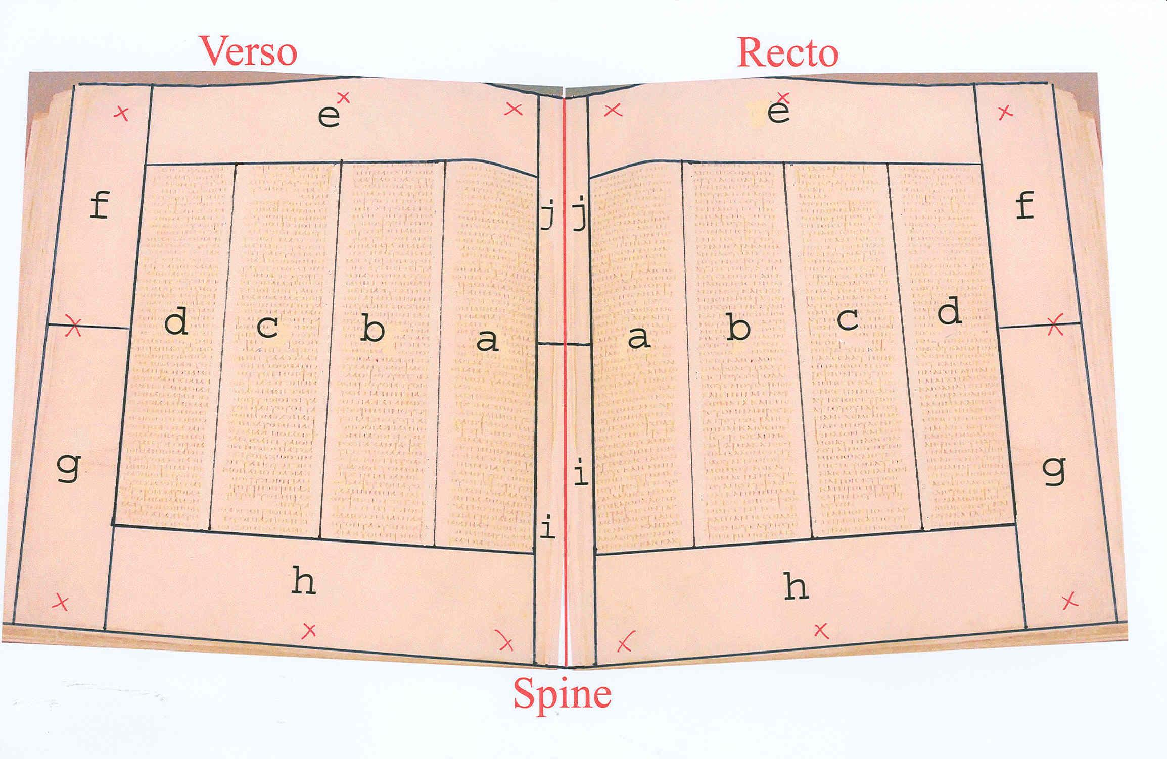
Codex Siniaticus

Slide 17
Conclusions
The use of METS is not expensive
  The use of standards cuts costs by building upon the work of others
  Automated production of METS documents is cheap
    Use of schema validated documents for automated creation
There are sometimes unavoidable costs
  Individual historical documents have costs associated with hand crafting metadata structures
  METS doesn’t introduce these costs, the process would always add expense

Slide 18
Where Next?
The British Library is involved in many single item Digitisations
  Codex Sinaiticus
    An early hand written master copy of the bible
  The Canterbury Tales
    Two early manuscripts including correlation of one edition to the other
  The Shakespeare Quartos
    Once again historical manuscripts with correlation between editions

